Slide 1


McMullen Booth
Title l Annual Meeting
2024-25

Slide 2



All About Title l
Title I is the largest federal assistance program for our nation’s schools.
The program serves 99 schools in Pinellas County including eligible students in 39 non-public schools.
The Title l goal is that every student achieves high levels of academic proficiency.
Notes:
Highlight the Title l Program here in Pinellas County.

Slide 3

2024-25 Title l Annual Parent Meeting
McMullen Booth International Studies Magnet/IB Candidate School
8/20/2024
5:45 pm
McMullen Booth Cafeteria
Stephanie Whitaker
Notes:
Evidence: Upload completed presentation and recorded feedback as part of the evidence to support the Annual Meeting Materials. Do not forget the sign-in sheets, and survey/feedback that you receive throughout the meeting.

Slide 4

Title I Funding Process
2. Florida Department of Education
1. Federal Government
4. McMullen Booth
3. Pinellas County Schools
Notes:
The Florida Department of Education receives funds from the federal government. Districts receive Title I funds from Department of Education, and the school district distributes these funds to schools based on the percentage of children eligible for free/reduced price lunch; however, students do not have to be from low-income families to receive help.

Slide 5


Title l Supplemental Resources
Definition: provided in addition to what is already present or available to compete or enhance it
Notes:
Definition: provided in addition to what is already present or available to complete or enhance it extra academic support and learning opportunities for economically disadvantaged students.

Slide 6
Let’s Celebrate!
***Highest Percentage of Points since 2013
****Review SIP 1 pager
Notes:
Based on the FAST data and school grades, there is a lot to celebrate!!
How did your Title I Resources support or enhance the work that you were able to get done?

Slide 7
Title I Programs Provide Supplemental Support
Supplemental Resource | Positive Impact
Additional supplemental personnel 1 Intensive Reading Teacher 2/3 of MTSS coach | Students receive access to specific interventions and more immediate supports
Additional training opportunities for school staff – Family Engagement Training | Staff understand the varying needs of our families
Extended Learning Opportunities (before and/or after school programs) | Access to extended opportunities to engage with standards
Parent and Family Engagement Resources and Training Workshops | Open House, 3 Family Breakfasts, 3 family nights, Special Olympics, 2 community/family events
Supplemental teaching materials, equipment, and technology | Materials as available to support small group work
Notes:
Use additional slides if necessary. This is where you want to really highlight Title I funding and how it positively impacts your scholars! Additional supplemental personnel (add specific positions)
If there are connections that they can make, they call it out!

Slide 8
Title I Schoolwide Planning and Input
First
Second
Last
Seek Input from school, family, and community members determine how Title I funds are used based on a needs assessment.
Please attend online or in-person meetings/trainings and complete surveys to provide input on Title I funding.
All Title I schools must document that parents are involved in the schoolwide planning process.
Notes:
Evidence for input – input from school can be a survey or notes, which include quotes related to what was shared as feedback AND how this input will be used to inform the PFEP and future engagement activities.
Evidence of Attendance – please include attendance of DIVERSE stakeholder group/s.

Slide 9

Title I Schoolwide Budget
McMullen Booth is provided (insert dollar amount) to pay for supplemental resources and programs for increased student achievement.
Total Budget 103,000
1 Intensive Reading Teacher- $20,000, 2/3 of an MTSS reading specialist $60,000 (+$20,000 fringe), 1 hour for Family Community Liasion $15.00/hour, $ to be utilized for supplies for all family events - $1000

Slide 10

Parent’s Right to Know
As a parent of a student attending a Pinellas County School Public School, you have the right to…
Be
Be provided information on your child’s level of achievement on assessments in Reading/Language Arts, Writing, Mathematics, and Science.
Request and receive information on the qualifications of your child’s teacher and supplemental personnel working with your child.
Be
Be notified of non-highly qualified or out-of-field teachers at the school.
Be
Be informed if your child is taught by a non-highly qualified teacher for four or more consecutive weeks.

Slide 11
Working Together for Student Success
School
School Improvement Plan (SIP)
Title
Title I Schoolwide Plan
Parent
Parent and Family Engagement Plan
School
School-Parent-Student Compact
Title l is now included as a part of the School Improvement Plan
Notes:
As a Title I parent you have the right to be involved in the development of the following plans and documents for our school which can be found on our website (insert website) to view as well as in the Parent Station located (insert location here).
Our school’s Title I Parent Station is located (insert location or photo of Title I Parent Station (front office and on the webpage). Please include photo as part of the evidence monitoring.
You will find a copy of our School Improvement Plan, Title I Schoolwide Plan, School’s PFEP, the School District’s PFEP, Parent’s Right to Know Memo, Upcoming Events, Compact, (insert other documents at your station)
School Improvement Plan (SIP)
Parent and Family Engagement Plan
Title I Schoolwide Plan
School-Parent-Student Compact

Slide 12

Parent-School-Student Compact
The purpose of the compact is to foster student achievement. By signing the Parent-School-Student Compact, (Insert name of school here), teachers, staff, parents and students agree to work together to share the responsibility of helping students meet or exceed state, district and school academic goals.
The Parent-School-Student Compact is updated every year to include parent, student, teacher, and staff input. Parent, student, teacher and staff comments are welcome at any time during the year.
Please review and sign your child’s Compact.
Our goal is to receive 100% signed compacts!
Notes:
At the elementary level, school compacts are used as a progress monitoring tool through the year during parent teacher conferences.

Slide 13

Parent and Family Engagement Plan (PFEP)
The PFEP Sections include information about the following:
  Parent trainings to increase student achievement
  Staff trainings for engaging parents
  Communication methods between home and school
  Flexible meeting times
  Accessibility for parents
  Coordinating with other Federal Programs
  To access the full LEA PFEP, please visit
  www.pcsb.org/titleone
Notes:
Provide information on the specific committees that parents can be involved. Include the purpose, date and time of meetings.
Explain the PFEP and its purpose.
Consider the evidence related Title I Crate, Sample of Evidence,

Slide 14


Florida Benchmark For Excellent Student Thinking Standards (B.E.S.T). You may read more information by visiting, www.fldoe.org.
Notes:
All curriculum, instruction and assessments are based on student-centered expectations.

Slide 15

School’s Curriculum
Florida Benchmark For Excellent Student Thinking Standards (B.E.S.T). form the framework of everything taught at school.
Core Curriculum (insert specifics)
  Reading
  Mathematics
  Writing
  Science
  Civics
Notes:
This slide is optional if this will be discussed with classroom teacher
School’s Curriculum
Describe and explain the curriculum (Specific names of texts)

Slide 16

  Available online at https://edudata.fldoe.org/ or Front Office

Slide 17

9/20- Family Breakfast- Hispanic Heritage Month Activities with an IB connection
8/27- Picture Day- Volunteers Needed
10/25- Trunk or Treat
11/6- SAC and STEM night
Veteran’s Day Celebration, December Family Breakfast, Winter Carnival (volunteers needed)
Notes:
Do you have a calendar of key events that are included in your PFEP.
Evidence – Consider this as evidence to include to support Family Engagement.

Slide 18
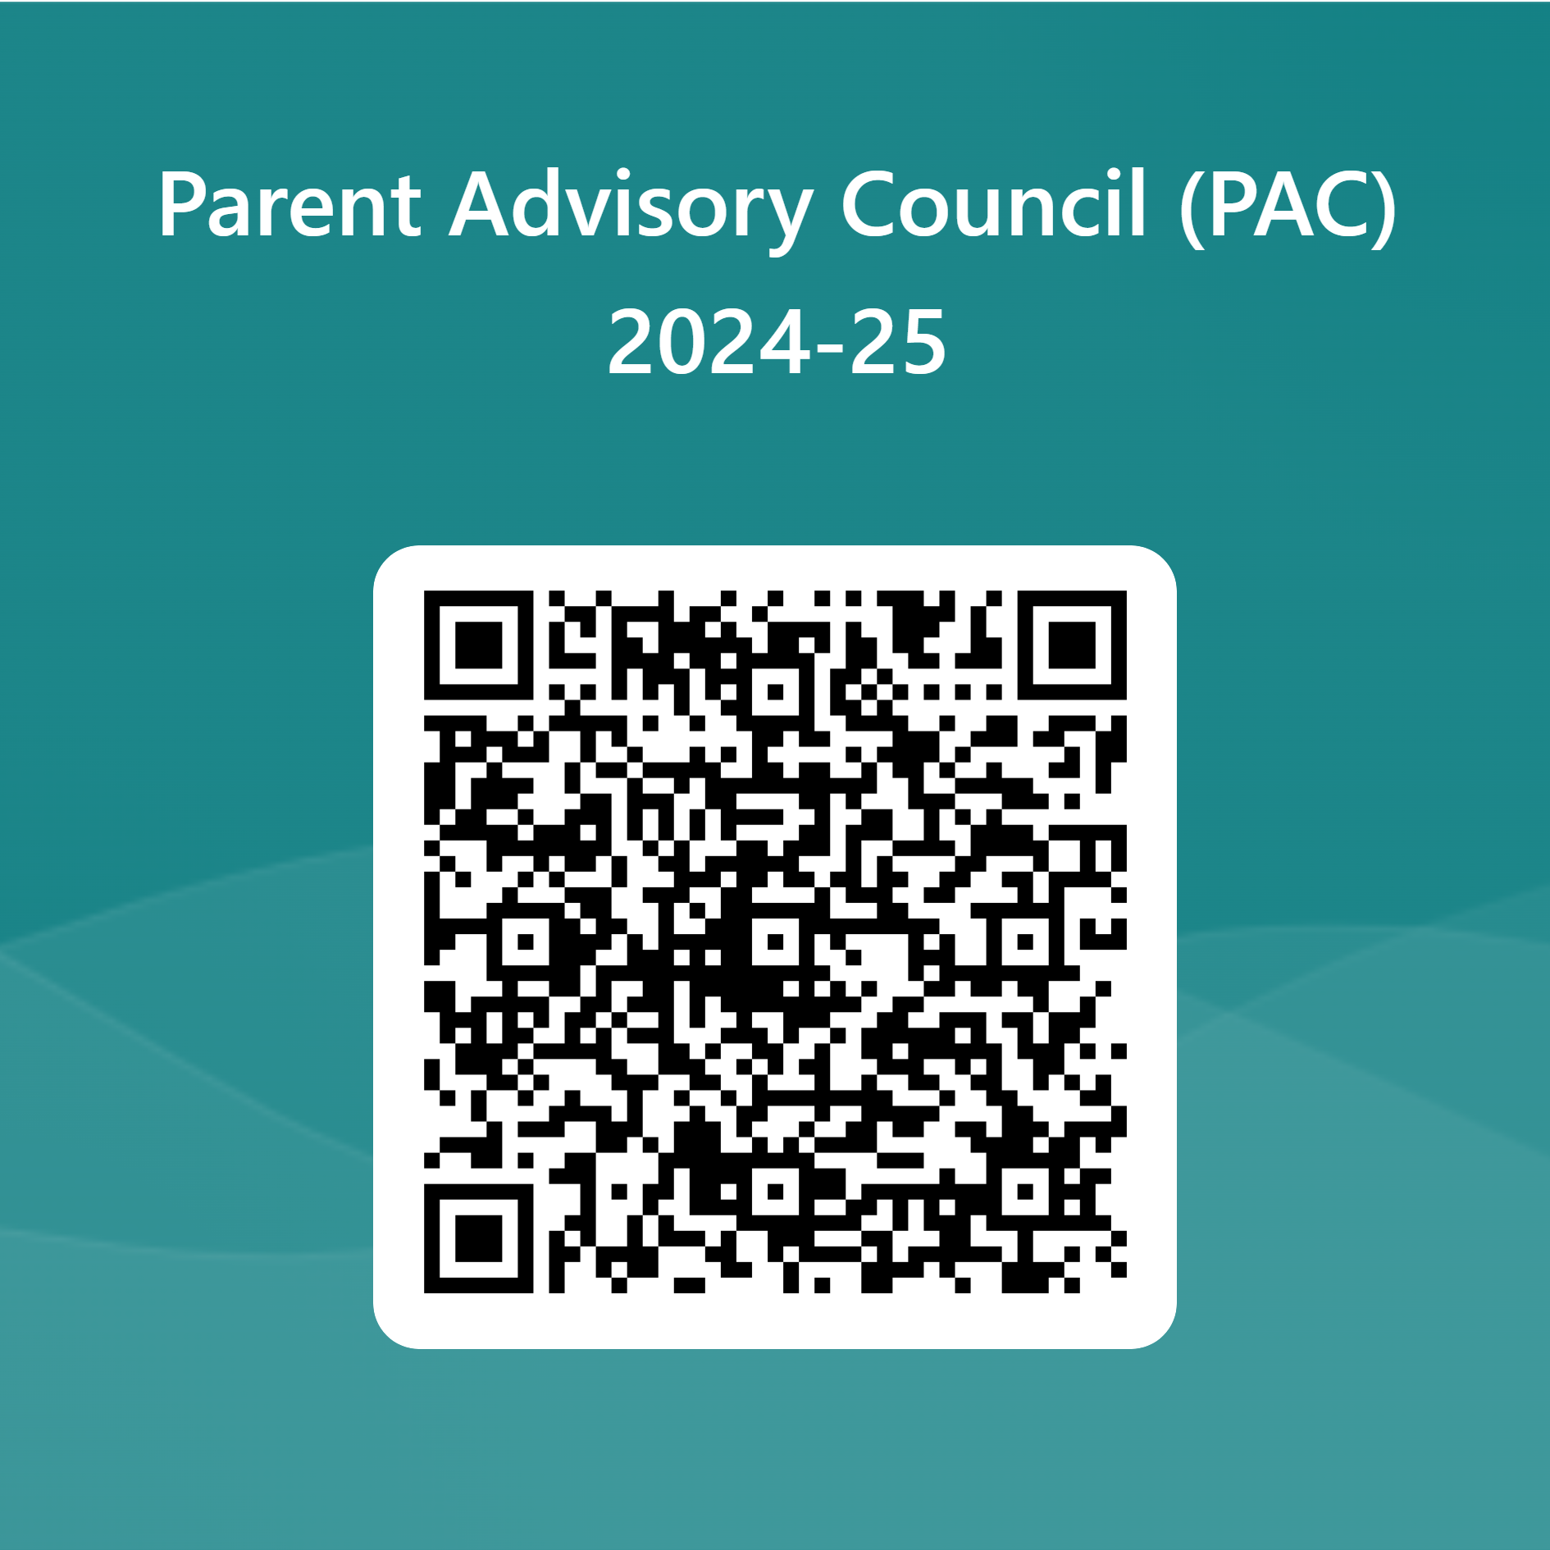

Parent Advisory Council (PAC)
The District has a Parent and Family Engagement Plan. The summary of the plan is in the Title I School & Family Partnership Overview.
You may access the full plan at www.pcsb.org/titleone
The Parent Advisory Council (PAC) is responsible for reviewing and revising the District PFEP.
PAC will meet virtually or in person with the district’s Title I staff.
Each school is committed to having at least one member representative in PAC.
PAC meets twice a year, if you are interested in representing our school please notify, Insert contact person
Notes:
Please add your PAC representative in slide and share with your Title I Specialist.
https://forms.office.com/r/r5daaMTENE\

Slide 19

Thank you for your time!

Slide 20
Please take the time to participate in our survey.
Complete Paper Survey before you leave.
Your feedback is greatly appreciated!
Notes:
Please duplicate Microsoft Forms provided or create school survey. To generate a QR code hover over your school’s survey and and right click. Create QR code for this page will be an option.
https://forms.office.com/Pages/ShareFormPage.aspx?id=BZM8c9c5GkaGb_3ye_PH_x-1YNVO6C1FkgA88U6PR2tUNEQzTU0wNkZXVUxVTlpEMU81NkJFMlJNTi4u&sharetoken=FXXhmgwFjSnl0sNz61ki

